Slide 1




Vocational Secondary School of Tourism and Catering Anton Štifanić
Poreč
Project – JOB PROMOTION
ISTRIA FOR YOUNG PEOPLE
Poreč 2013

Slide 2
PROJECT AIM – JOB PROMOTION
Istria for young people
to stimulate the development of the entrepreneurial culture and the participation of young people in the entrepreneurship
to acquire the modern knowledge and skills adjusted to trends and needs of the tourism sector
to apply the acquired knowledge in the regular teaching process
to apply the project to the DMC to all the institutions which deal with tourism in our town, county and state in order to create an even better new tourism product and to complete the current one and the image of Istra
to learn what a tourism product – Istria as tourism destination is and how to properly introduce (sell) it
to relate to the tourism development strategy of Croatia

Slide 3
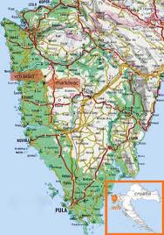
ABOUT ISTRIA
Geographical position:
the westernmost region of the Republic of Croatia
The biggest Adriatic peninsula
Surface area: 2.820 km2
Number of inhabitants: 206.344

Slide 4
NATURAL RESOURCES
rich and well-preserved natural heritage
535 km of indented coastline
protected areas
natural parks
different plant and animal species
the Mediterranean climate
crystal clear sea water

Slide 5
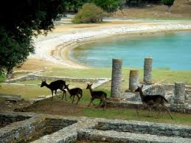
NATURAL ATTRACTIONS
1 national park
1 nature park
1 special sea reserve
1 zoological natural monument
2 special forest vegetation reserves
2 monuments of park architecture
3 geo morphological monuments of nature
3 botanic natural monuments
4 forest parks
6 significant landscapes

Slide 6
HISTORICAL AND CULTURAL HERITAGE
The Euphrasian Basilica
(UNESCO World Heritage)
The Roman amphitheatre
Medieval towns and castle ruins on the hills
Triumphal Arch of Sergius
The Augustus Temple
Churches with fresco paintings
„ the Dance of the Dead” in Beram ….

Slide 7
TRANSPORT
Roads
good infrastructure
bad public transport network - too expensive
railways, maritime and air transport
bad transport connection
telecommunication and social networks – a need to follow trends

Slide 8
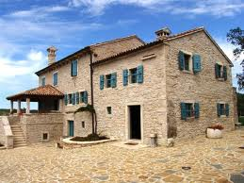
ACCOMODATION FACILITIES
The accommodation facilities follow modern trends and they have reached the European standards
4 youth hostels –Fažana, Roč, Savudrija, Motovun
Type of facility | Capacity: | %
HOTELS | 26 049 | 10,5%
CAMPSITES | 111 620 | 44,9%
Apartments and tourism areas | 31 350 | 12,6%
PRIVATE ACCOMODATION | 58 810 | 23,7%
Nautical tourism ports | 15 020 | 6%
Other | 5 814 | 2,3 %
HOSTELS | ????
TOTAL | 248 663 | 100%

Slide 9
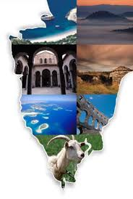
DESTINATION IMAGE
Istria - vacation
Well-known products= sun and sea
Istria – ADVENTURE
High-quality products
Istria for young people
Valorisation of the destination potential

Slide 10
WHAT WE HAVE
Environmentally unpolluted nature and sea
Not a super- built-up area
Human resources – young people
High-quality food
Historical and cultural heritage
Emissive markets proximity
Short distances between the coastal and continental area
Preserved original way of life
Accommodation facilities of average quality - hotels, campsites, apartments
WHAT WE DON’T HAVE
Attraction and adventure - the magic
High-quality entertainment
Hobbyist and recreation programmes
High-quality infrastructure and transport
Shopping offer
Quality products - excursions
Higher quality accommodation facilities and HOSTELS
Recognizable oenology and gastro services
Low cost – prices for young people

Slide 11
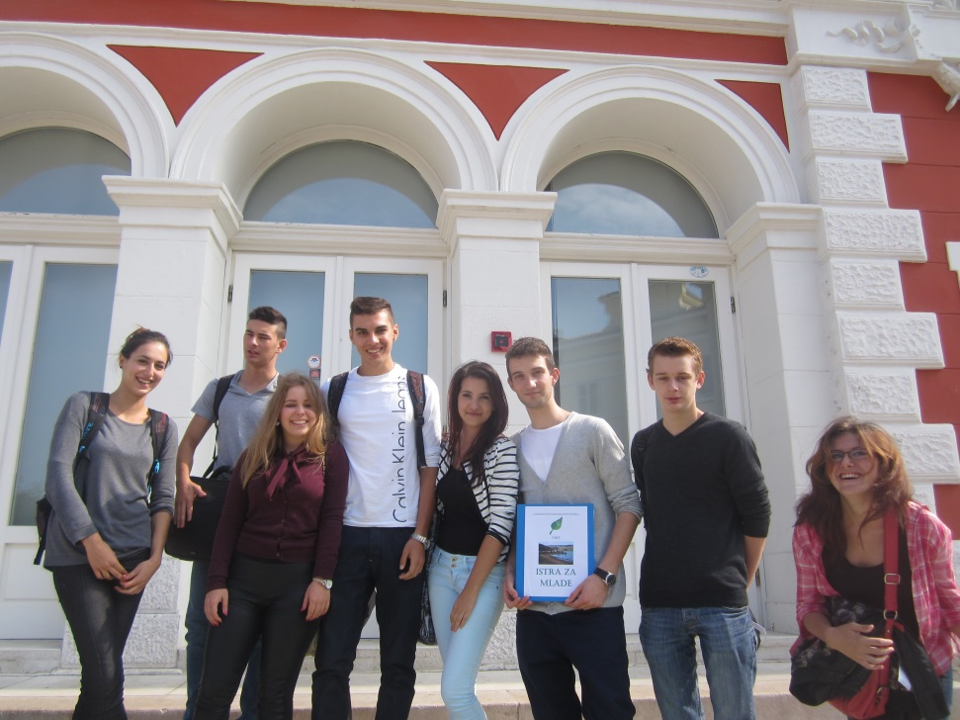
What we want
to preserve a clean environment
Hostels
Low cost - prices for young people
Different products for the young people target group
Season extending to nine months
New employment of young workers
High-quality tourism
Better quality of local life
Preservation of local identity and culture
Istria as destination of unforgettable leisure, adventure, social interactions …
Be attractive for the capital investments
A better and longer occupancy of accomodation capacity
The recognizable image of Istria as tourism destination Lifestyle: Istria for young people

Slide 12
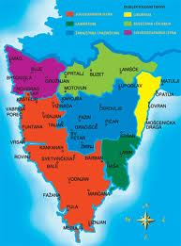
ISTRIA - DMC
The tourist destination has been a touristically organised and recognizable space
DMC – the designated competent authority of marketing management destination
The destination management company (DMC) is imagined as the leading organisation in the Istria destination
A business entity of marketing management

Slide 13
Organizational structure of DMC-ISTRIA
DMC - ISTRA
The Golden Age
Empty nesters
YOUNG age 16-24
DINKS
Familiy
Project team
ISTRIA FOR YOUNG PEOPLE
Young adventurers
Secondary school-leaving students
Students
Wish product
Special projects for young people
Vision and strategy planning
Destination product offer development and design
Marketing cluster
Controlling

Slide 14
ORGANIZATIONAL STRUCTURE OF
DMC-Istria
Organizational unit - ISTRIA FOR YOUNG PEOPLE
Project team- ISTRIA FOR YOUNG PEOPLE
(age 16-24)
Promotion
Young adventurers
Secondary school-leaving students
Special projects for young people
Tailor made wish product
Students
Products
Communication-booking
Controlling

Slide 15
ISTRIA FOR YOUNG PEOPLE
Young adventurers
P1
P2
Secondary school-leaving students
Travel through time
Legends’ itineraries
Students
Gastro stories
Tailor made wish arrangements
Special projects
P3
P3
Istria adventure – discovering Istria
Speleological adventure
From Istria to the stars
P2
Educational arrangements
From the dusk to the dawn

Slide 16
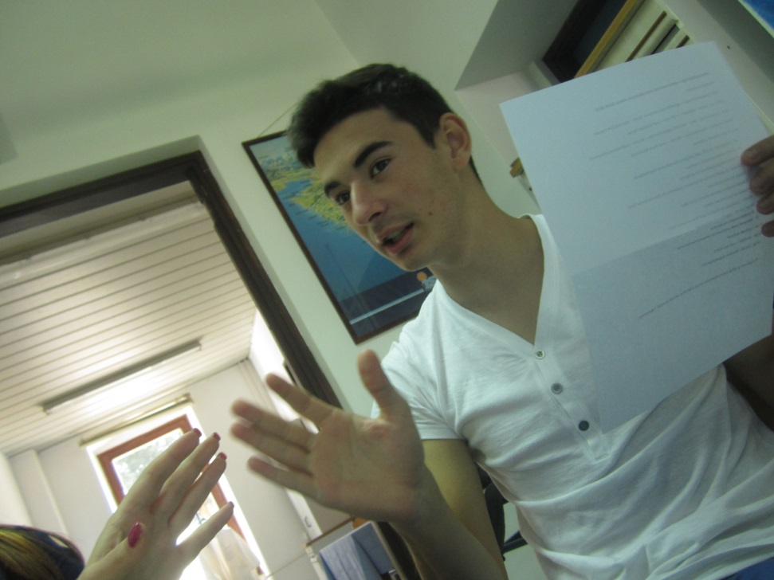
Our goals:
Contribution to the Istria destination attractiveness
Contribution to the adventure design and quality stay of young people at the destination
Inciting interests of young people for the tourist destination
Promotion and sale of the Istria destination as tourism product through tourist centres specialised for young people
Supporting the tourism development of the Istria destination
Contribution to a higher quality process of the destination marketing

Slide 17
MARKETING PROCESS DESIGN
OF ISTRIA AS TOURISM DESTINATION
RESEARCH – data collecting about Istria as destination and target market young people
age 16-24
PRODUCT MARKET LAUNCH – Project presentation
NEW PRODUCT PLANNING AND DEVELOPMENT
PRODUCT TESTING
PROJECT INFORMATISATION
COMPARISON of the current offer and new option identification

Slide 18
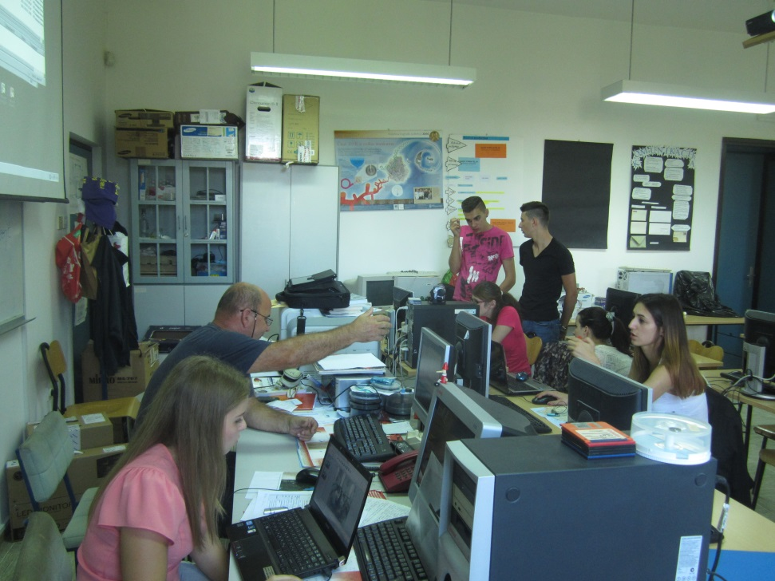
1. Project team activities have started by RESEARCHING AND
DESTINATION DATA COLLECTION
about the destination natural attractions
destination social attractions
entertainment facilities in Istria
accomodation and gastro offer (hostels)
public transport ( availability) and prices
atmosphere
Events – festivals, manifestations, educational activities, adventurous and sport activities …
Use of SECONDARY INFORMATION
SOURCES

Slide 19
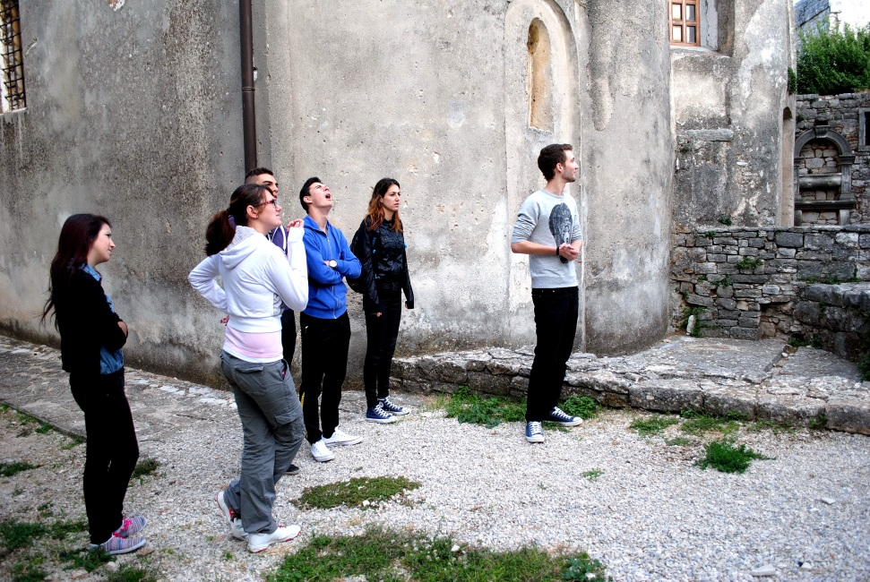
TARGET MARKET data collection- CONSUMER SEGMENTATION
Data collection about the target market interested in our product - Istria destination– consumer segment YOUNG PEOPLE age 16-24
Our target market are:
Schools – school partners (from various projects and associations) nationally and abroad – more than 500 schools
Tourism and catering schools and other secondary schools in Croatia
All faculties in Croatia

Slide 20
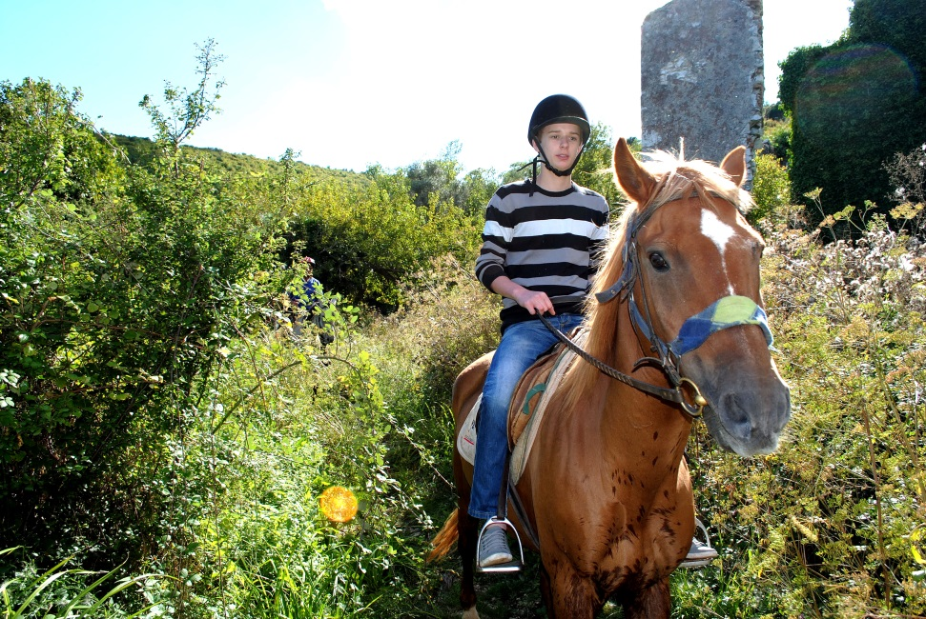
2. Current offer comparison
Process and analysis (interpretation) phase of collected data
Creating the bank of photos and recorded material, data
Identifying new tender possibilities
Identification of emerging trends
Designing activities for our target group – YOUNG PEOPLE (age 16-24)

Slide 21
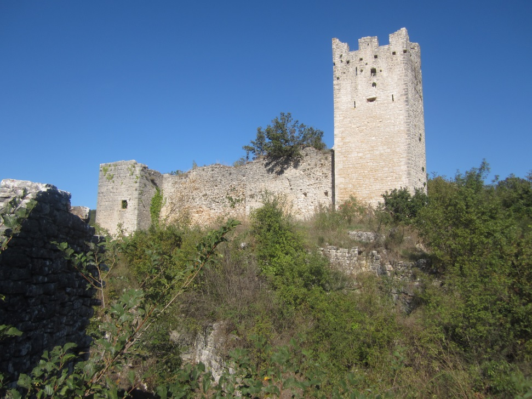
3. New product planning and development
Planning of a recognizable tourism product of high quality
The project team will use the current tourism product, will modify it and develop a new one
e.g.
Tourism products according to the consumers' segments:
SPECIAL PROJECTS FOR YOUNG PEOPLE
SECONDARY SCHOOL LEAVERS
STUDENTS
WISH PRODUCTS
YOUNG ADVENTURERS

Slide 22
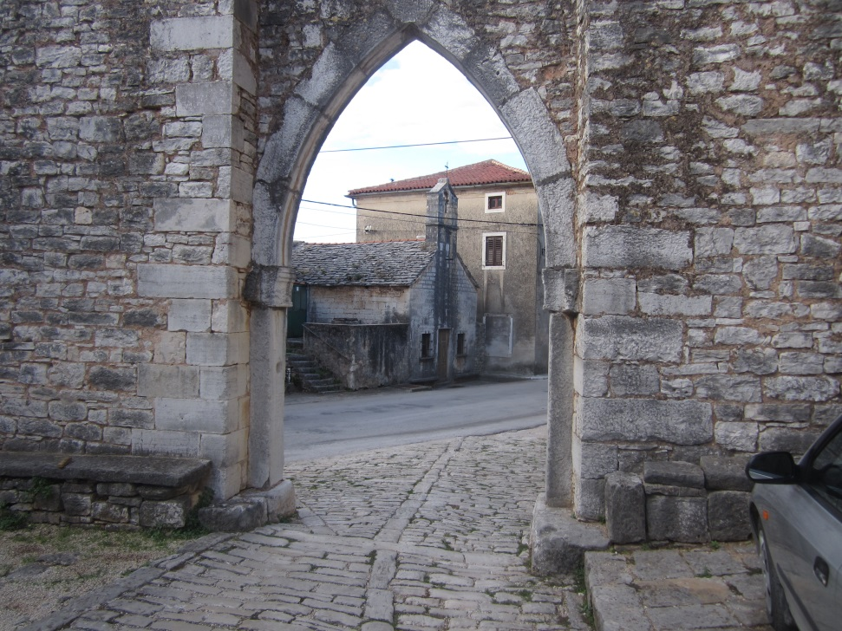
New offer development for young people- arrangements for YOUNG PEOPLE
ISTRA ADVENTURE – discovering Istria
LEGENDS’ ITINERARIES
FROM THE DUSK TO THE DAWN
GASTRO STORIES
TRAVELLING THROUGH THE TIME

Slide 23
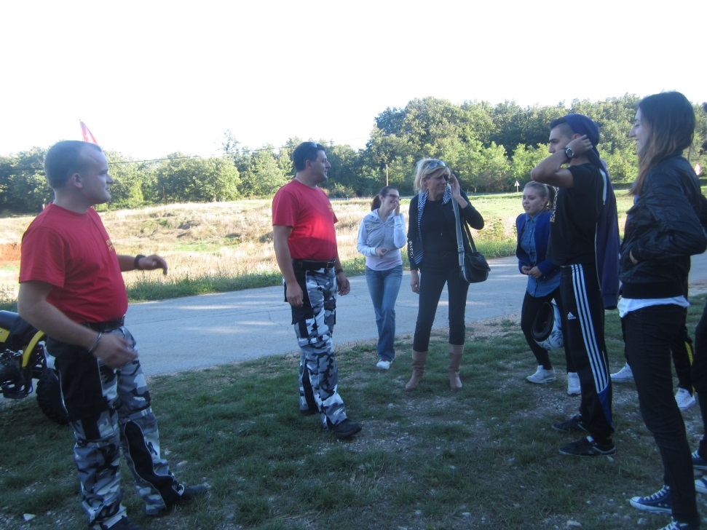
4. PRODUCT TESTING
The project team has tested and PERFORMED the developed arrangement- the excursion, during which areas and contents which need to be improved have been identified before the tourism product (excursion) launch on the market
20/11/2013 we tested the excursion ISTRIA ADVENTURE – discovering Istria

Slide 24
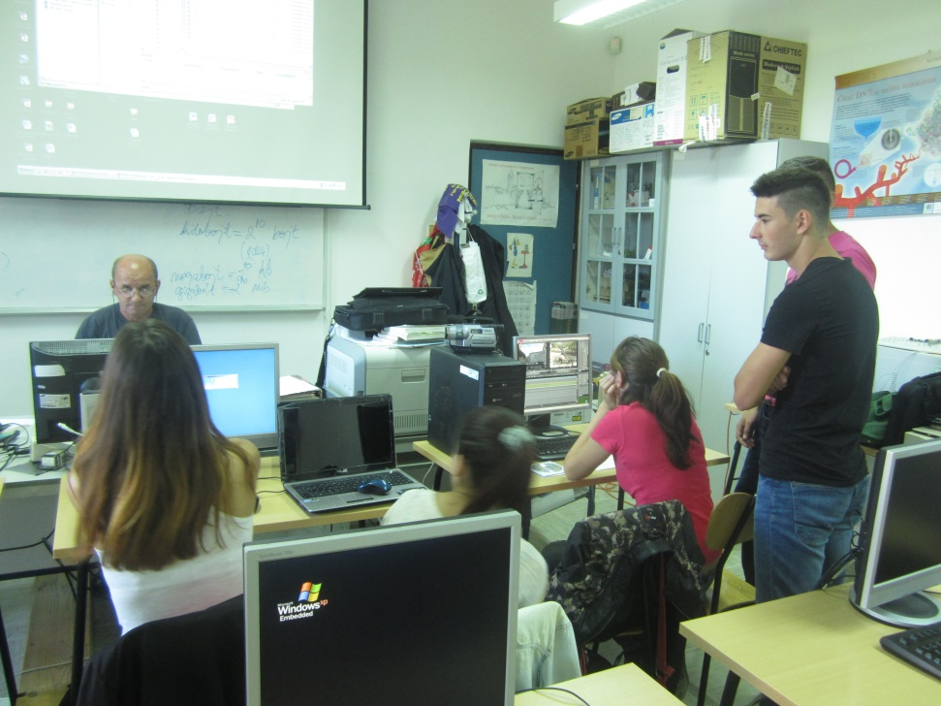
5. PROJECT INFORMATISATION:
project video recording production (installation)
video clip production
Power Point presentation production
Slide show production
uploading to the school website to promote the product and the protection of the developed tourism product
Facebook and other social networks
YouTube (video clip)
production of the presentation folder
bookmarkers' production

Slide 25
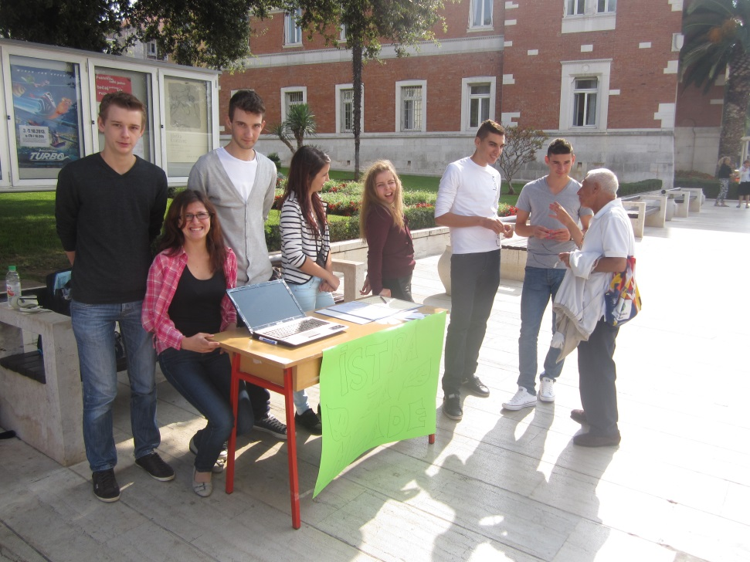
6. PRESENTATION OF THE PRODUCT TO THE MARKET
Newsletter- to the partner schools
Tourism Board display of the City of Poreč
Medias: radio, magazine „Porečki glasnik“ (The Poreč Herald)
26/09/- Europen Day of Languages- Public work results presentation in Croatian and foreign languages- German, English, Italian- at the Narodni trg in Poreč (The Public Square)
27/09/- Tourism Day- project presentation to the community- at our school

Slide 26

PROMOTION of Istria for young people
SOCIAL NETWORKS - POSITIONING OF ISTRIA FOR YOUNG PEOPLE ON SOCIAL NETWORKS:
a)Facebook b)Twitter C)YouTube D) Foursquare is)Flickr f) Pinterest
“In 2010 the society leaves the information age (the Google) and enters the buyers' age (the Apple, Facebook). In that period the influence results from the interaction with the strengthened buyers.”
Source: Forrester research, 2011

Slide 27
NEW TRENDS
Consumers' cycle in the new environment:
DREAMING– looking for inspiration: Internet as main source
RESEARCHING–web search engines BOOKING–online and mobile booking
EXPERIENCING– researching and booking go on during the journey
SHARING– growing / crucial role of social networks – the web has becomes more and more mobile
2013 / 2014 Internet access via mobile platforms (iPhone, Android, iPad...) will exceed the one via fixed computers

Slide 28
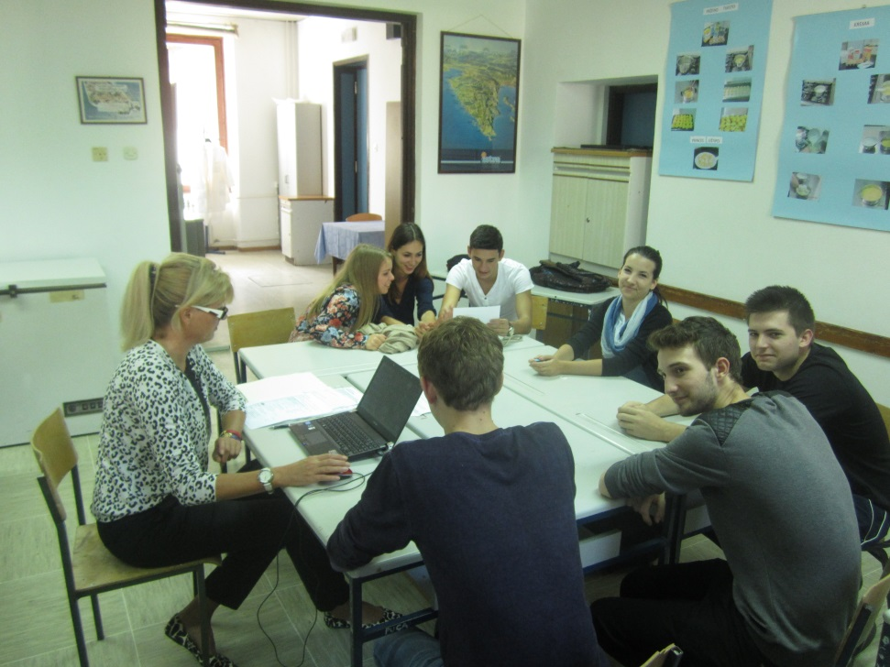
OUR FUTURE PROFESSIONS :
Journey manager
Tourist guide
Tourist agency employee
Travel agency manager
Tour operator
TIC manager
Booking manager in the DMC department of ISTRIA FOR YOUNG PEOPLE
Head of sales in the department ISTRIA FOR YOUNG PEOPLE
YOUNG ENTREPRENEURS......

Slide 29
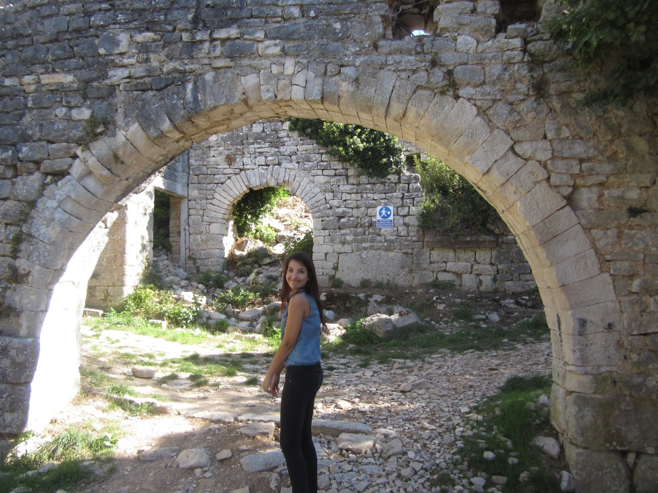
Institutions we have consulted during the project development:
Tourist Board of the City of Poreč
Tourist Board of the Istrian County
Tourism Institute of Poreč
Tourism administrative department of the Istrian County

Slide 30
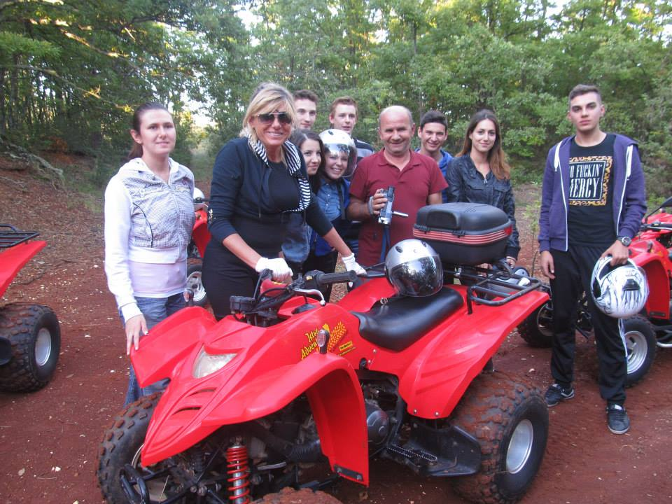
SCHOOL PROJECT TEAM:
STUDENTS:
Nikolina Hercig
Nedim Bjelić
Paola Radolović-Ježek
Anna Klarić
Monica Peranović
Deni Knapić
Damir Štefanić
Kristijan Herak
TEACHERS:
Josip Klarić
Tatjana Gulić Pisarević
Vilma Čehić-Janjuš and
Headmistress: Vesna Baranašić, prof.

Slide 31
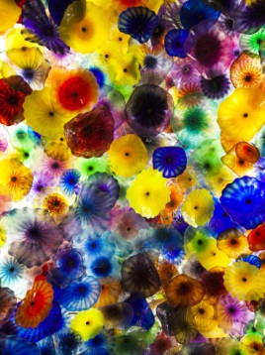
“A journey of a thousand miles begins with a single step”
Confucius

Slide 32
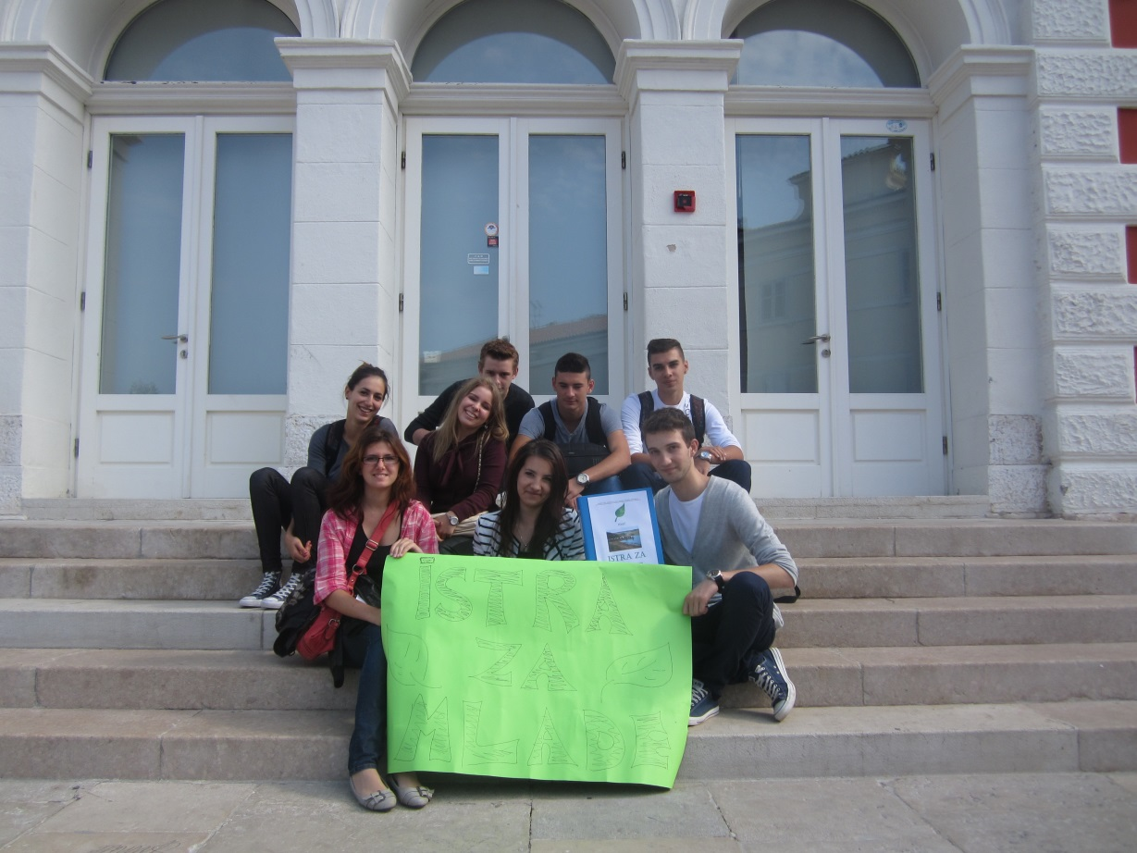
Thank you!
THANK YOU TO THE MINISTRY OF TOURISM

